Slide 1
The Battle of Neighborhood
( IBM Applied Data Science Capstone )
Opening a New Shopping Mall in Kuala Lumpur, Malaysia
By : Sumit Prakashrao Mohod
June 2021

Slide 2
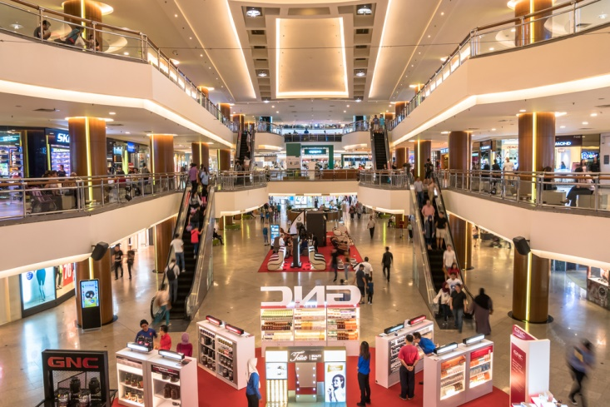
Business Problem :
Location of Shopping Mall is one of the most important decision that will determine whether the Mall will be a success or a failure.
Objective : To analyze and select the best locations in the city of Kuala Lumpur, Malaysia to open a new Shopping Mall.
This Project is timely as the city is currently suffering from oversupply of shopping malls.
Business Question : In the city of Kuala Lumpur, Malaysia, if a property developer is looking to open a new Shopping Mall, where would you recommend that they open it?

Slide 3
Data :
Data Required :
List of neighborhoods in Kuala Lumpur, Malaysia
Latitude and Longitude coordinates of the neighborhoods
Venue data, particularly data related to Shopping Malls
Sources of Data :
Wikipedia page of neighborhoods of Kuala Lumpur, Malaysia (https://en.wikipedia.org/wiki/Category:Suburbs_in_Kuala_Lumpur)
Geocoder library for latitude and longitude coordinates
Foursquare API for venue data

Slide 4
Methodology :
Web Scrapping Wikipedia page for neighborhoods list
Get latitude and longitude coordinates using Geocoder
Use Foursquare API to get venue data
Group data by neighborhood and taking the mean of the frequency of occurrence
of each venue category
Filter venue category by Shopping Mall
Perform clustering on the data by using k-means clustering
Visualize the clusters in a map using Folium

Slide 5
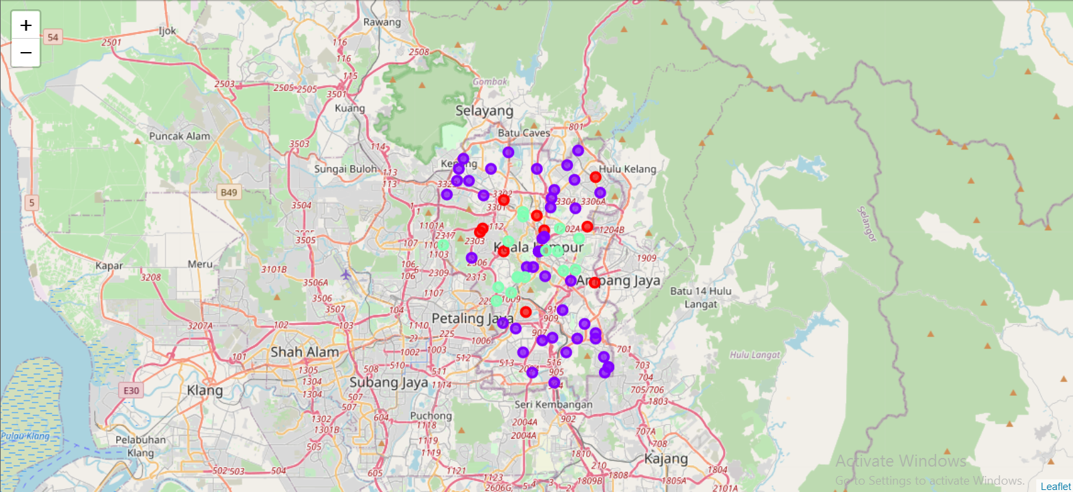

Slide 6
Result :
Categorized the neighborhoods into 3 clusters :
Cluster 0 : Neighborhoods with moderate number of shopping malls
Cluster 1 : Neighborhoods with low number to no existence of shopping malls
Cluster 2 : Neighborhoods with high concentration of shopping malls

Slide 7
Discussion :
Most of the shopping malls are concentrated in the central area of the city
Highest number in cluster 2 and moderate number in cluster 0
Cluster 1 has very low number to no shopping mall in the neighborhoods
Oversupply of shopping malls mostly happened in central area of the city, with the suburb area still have very few shopping malls

Slide 8
Recommendations :
Open new Shopping Malls in neighborhoods in cluster 1 with little to no competition
Can also open in neighborhoods in cluster 0 with moderate competition if have unique selling propositions to stand out from the competition
Avoid neighborhoods in cluster 2, already high concentration of shopping malls and intense competition

Slide 9
Conclusion :
Answer to business question : The neighborhoods in cluster 1 are the most preferred locations to open a new Shopping Mall
Findings of this project will help the relevant stakeholders to capitalize on the opportunities on high potential locations while avoiding overcrowded areas in their decisions to open a new Shopping Mall

Slide 10


